Slide 1
Opponent exploitation
Tuomas Sandholm

Slide 2
Traditionally two approaches to tackling games
Game theory approach (abstraction+equilibrium finding)
  Safe in 2-person 0-sum games
  Doesn’t maximally exploit weaknesses in opponent(s)
Opponent modeling/exploitation
  Needs prohibitively many repetitions to learn in large games (loses too much during learning)
    Crushed by game theory approach in Texas Hold’em
    Same would be true of no-regret learning algorithms
  Get-taught-and-exploited problem [Sandholm AIJ-07]
Notes:
Crushed by game theory approach in Texas Hold’em, even with just 2 players and limit betting

Slide 3
Let’s hybridize the two approaches
Start playing based on pre-computed (near-)equilibrium
As we learn opponent(s) deviate from equilibrium, adjust our strategy to exploit their weaknesses
  Adjust more in points of game where more data now available
  Requires no prior knowledge about opponent
Significantly outperforms game-theory-based base strategy in 2-player limit Texas Hold’em against
  trivial opponents
  weak opponents from AAAI computer poker competitions
Don’t have to turn this on against strong opponents
[Ganzfried & Sandholm AAMAS-11]

Slide 4
Let’s hybridize the two approaches
Start playing based on game theory approach
As we learn opponent(s) deviate from equilibrium, start adjusting our strategy to exploit their weaknesses
  Requires no prior knowledge about the opponent
  Adjust more in points of the game for which more data is now available
[Ganzfried & Sandholm AAMAS-11]

Slide 5
Deviation-Based Best Response (DBBR) algorithm
(generalizes to multi-player games)
Compute an approximate equilibrium
Maintain counters of opponent’s play throughout the match
for n = 1 to |public histories|
  Compute posterior action probabilities at n (using a Dirichlet prior)
  Compute posterior bucket probabilities
  Compute model of opponent’s strategy at n
Return best response to the opponent model
Many ways to define opponent’s “best” strategy that is consistent with bucket probabilities
  L₁ or L₂ distance to equilibrium strategy
  Custom weight-shifting algorithm, …
Notes:
(Diffs to Alberta algorithms (at least one of these applies to each of theirs): 1) they worked on tiny games like Kuhn poker or rock-scissors paper, 2) they precomputed a handful of strategies and used an experts algorithm to just choose among them, 3) they assumed massive amounts of hand histories available before play, or 4) they assumed opponent’s private information was observable.)
(We had just actions in the public history, not board.)

Slide 6
Experiments on opponent exploitation
Significantly outperforms game-theory-based base strategy in 2-player limit Texas Hold’em against
  trivial opponents
  weak opponents from AAAI computer poker competitions
Don’t have to turn this on against strong opponents
Notes:
Base strategy = GS5

Slide 7
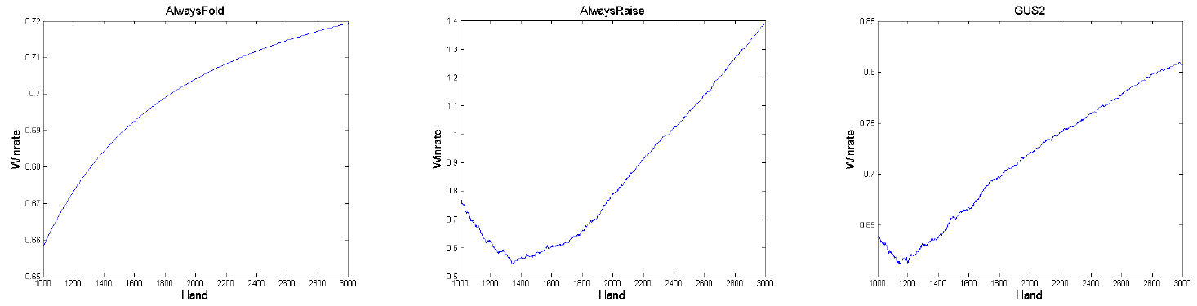
Experiments on opponent exploitation
Significantly outperforms game-theory-based base strategy in 2-player limit Texas Hold’em against
  trivial opponents
  weak opponents from AAAI computer poker competitions
Don’t have to turn this on against strong opponents
Opponent: Always fold
Opponent: Always raise
Opponent: GUS2
Win
rate
1,000
3,000
#hands
Notes:
Base strategy = GS5

Slide 8
Other modern approaches to opponent exploitation
ε-safe best response
[Johanson, Zinkevich & Bowling NIPS-07, Johanson & Bowling AISTATS-09]
Precompute a small number of strong strategies. Use no-regret learning to choose among them
[Bard, Johanson, Burch & Bowling AAMAS-13]

Slide 9
Safe opponent exploitation ?
Definition. Safe strategy achieves at least the value of the (repeated) game in expectation
Is safe exploitation possible (beyond selecting among equilibrium strategies)?
[Ganzfried & Sandholm EC-12, TEAC 2015]
Notes:
i.e., cannot be exploited due to the get-taught-and-exploited problem

Slide 10
When can opponent be exploited safely?
Opponent played an (iterated weakly) dominated strategy?
Opponent played a strategy that isn’t in the support of any eq?
Definition. We received a gift if opponent played a strategy such that we have an equilibrium strategy for which the opponent’s strategy isn’t a best response
Theorem. Safe exploitation is possible iff the game has gifts
E.g., rock-paper-scissors doesn’t have gifts
 | L | M | R
U | 3 | 2 | 10
D | 2 | 3 | 0
R is a gift
but not iteratively weakly dominated
R isn’t in the support of any equilibrium
but is also not a gift
 | L | R
U | 0 | 0
D | -2 | 1
Notes:
(Can determine in polytime whether a game has gifts.)

Slide 11

Exploitation algorithms
Risk what you’ve won so far
Risk what you’ve won so far in expectation (over nature’s & own randomization), i.e., risk the gifts received
  Assuming the opponent plays a nemesis in states where we don’t know
…
Theorem. A strategy for a 2-player 0-sum game is safe iff it never risks more than the gifts received according to #2
Can be used to make any opponent model / exploitation algorithm safe
No prior (non-eq) opponent exploitation algorithms are safe
#2 experimentally better than more conservative safe exploitation algs
Suffices to lower bound opponent’s mistakes
Notes:
#1 Doesn’t differentiate whether winnings are due to opponent’s mistakes (gifts) or our luck

Slide 12
Another opponent exploitation topic:
Learning to win in finite-time zero-sum games
Assumptions:
  Score doesn’t matter, except that player with higher score wins
  Finite (& discrete) time
  Opponent’s strategy is fixed & known => treated as part of the environment
Modeled as finite-horizon undiscounted MDP
Solved using value iteration
  Efficient because
    every layer contains transitions only into the next layer, and
    at iteration k, the only values that change are those for states (s, t, ir) such that t = k
  Quadratic in state space size and in time horizon
    => Heuristic simplification techniques introduced for large problems
      Only change the policy every k steps
      Only change policy in the last k steps
      Logarithmic time resolution (finer time resolution near the end)
[McMillen & Veloso AAAI-07]

Slide 13
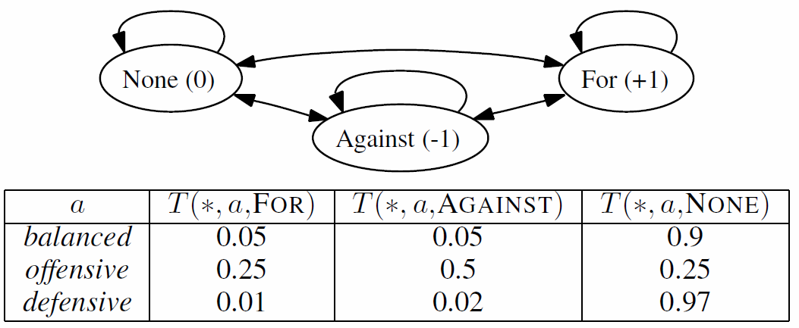
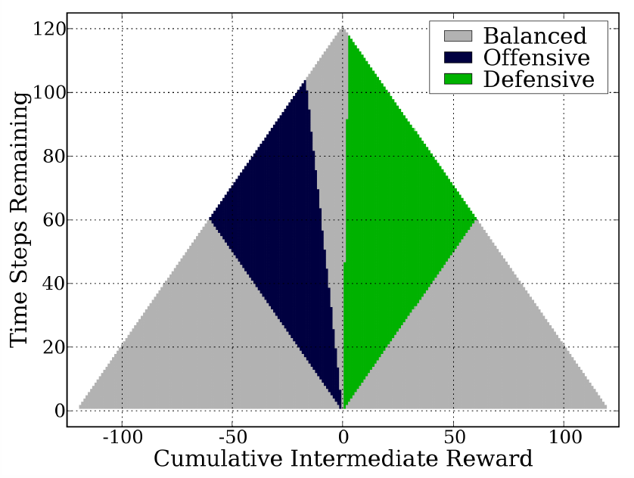
Example
Input
(i.e., setting):
Output
(i.e., optimal strategy):
These kinds of strategies happen in many sports, e.g., sailing, hockey, soccer, …

Slide 14
Current & future research on opponent exploitation
Understanding exploration vs exploitation vs safety
In DBBR, what if there are multiple equilibria or near-equilibria?
Application to other games (medicine [Kroer & Sandholm IJCAI-16], cybersecurity, etc.)
Notes:
(Ex ante & ex post)

